Slide 1
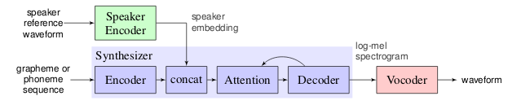
Voice Cloning using Deep Learning
Developed by: Ye Jia, Yu zhang, Ron J Weiss(First author) – Google Inc
Open source code by: Corentin Jemine
Calling your mother on your voice and talking on anything I want. How frightening can it be? Using new advances in Deep Learning, we can do that, from transfer Learning from Speaker verification to Multispeaker Text-to speech Synthesis(SV2TTS) with a vocoder that works in real-time.
Real Time Voice Cloning
https://github.com/CorentinJ/Real-Time-Voice-Cloning
Popular research paper implementation of Transfer Learning from Speaker Verification to Multispeaker Text-To-Speech synthesis.
Related Technologies
Google assistant has already implemented such a system
All the components needed for this project like Vocoder using WaveRNN, Tacotron 2 (synthesizer), GE2E (encoder) are presently implemented
Google Text to Speech API
Why Malayalam need such a system?
https://github.com/CorentinJ/Real-Time-Voice-Cloning
Popular research paper implementation of Transfer Learning from Speaker Verification to Multispeaker Text-To-Speech synthesis.
Components of the architecture
A recurrent speaker encoder which computes a fixed dimensional vector from a speech signal.
Sequence-to-sequence synthesizer which predicts a mel spectrogram from a sequence of grapheme inputs, conditioned on speaker emedding vector.
An autoregressive Wavenet vocoder, which converts the spectogram into time domain waveforms.

